Slide 1
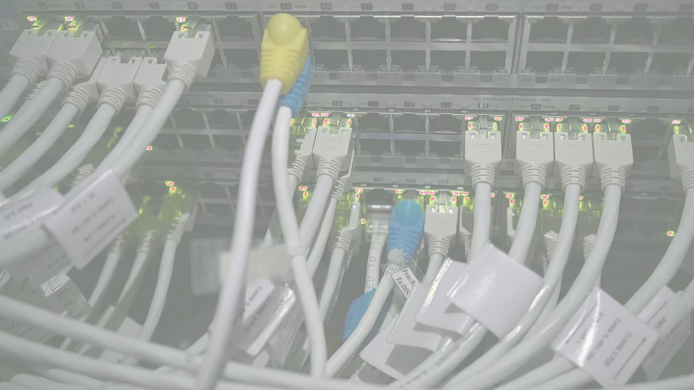
Computer Networks [Introductory]

Slide 2
Course Introduction
This course introduces the basic concept of computer network to the students.
Network layers, Network models (OSI, TCP/IP) and protocol standards are part of the course.

Slide 3
Course Learning Outcomes (CLOs)
Describe the key terminologies and technologies of computer networks
Explain the services and functions provided by each layer in the Internet protocol stack. Identify various internetworking devices and protocols and their functions in a networking. Analyze working and performance of key technologies, algorithms and protocols.
Build Computer Network on various Topologies.

Slide 4
Course Outline
Introduction and protocols architecture,
basic concepts of networking,
network topologies,
layered architecture,
physical layer functionality,
data link layer functionality,
multiple access techniques,
circuit switching and packet switching,
LAN technologies,

Slide 5
Course Outline
wireless networks,
MAC addressing,
networking devices,
network layer protocols,
IPv4 and IPv6,
IP addressing, sub netting, CIDR, routing protocols,
transport layer protocols,
ports and sockets,
connection establishment,
flow and congestion control,
application layer protocols,
latest trends in computer networks.

Slide 6
Reference Book
Computer Networking: A Top-Down Approach Featuring the Internet, 6th edition by James F. Kurose and Keith W. Ross
Computer Networks, 5th Edition by Andrew S. Tanenbaum
Data and Computer Communications, 10th Edition by William Stallings
Data Communication and Computer Networks, 5th Edition by Behrouz A. Forouzan

Slide 7
What is Computer Network?
A computer network is a set of devices/nodes connected by links so that various devices can interact with each other to share resources and information.
A node can be computer, printer, or any other device capable of sending or receiving the data.
The links connecting the nodes are known as communication channels.

Slide 8
What is Computer Network?
Computer Network uses distributed processing in which task is divided among several computers. Instead of a single computer handling an entire task, each separate computer handles a subset.
This aligns with the correct understanding of distributed processing, where multiple computers work on different parts of a task.

Slide 9
Advantages of Distributed Processing
Security:
It provides limited interaction that a user can have with the entire system.
For example, a bank allows the users to access their own accounts through an ATM without allowing them to access the bank's entire database.
Faster problem solving:
Multiple computers can solve the problem faster than a single machine working alone.
Security through redundancy:
Multiple computers running the same program at the same time can provide the security through redundancy.
For example, if four computers run the same program and any computer has a hardware error, then other computers can override it.

Slide 10
Uses of Computer Network
Resource sharing:
Resource sharing is the sharing of resources such as programs, printers, and data among the users on the network without the requirement of the physical location of the resource and user.
Server-Client model:
Computer networking is used in the server-client model. A server is a central computer used to store the information and maintained by the system administrator.
Clients are the machines used to access the information stored in the server remotely.
Communication medium:
Computer network behaves as a communication medium among the users.
For example, a company contains more than one computer has an email system which the employees use for daily
communication.
E-commerce:
Computer network is also important in businesses. We can do the business over the internet.
For example, amazon.com is doing their business over the internet, i.e., they are doing their business over the internet.

Slide 11
Uses of Computer Network
Fast and Easy Communication:
Networks enable all types of digital communication, like emails, messaging, file sharing, video calls, and streaming.
More Storage Space:
Suppose if we don’t have a cloud storage then we have to store data in physical files that will consume a physical space
so computer network provide a storage for storing data.
Easier Sharing of Information:
Networks make it simpler for users and teams to share resources and information. Teams can collaborate more easily, and users get faster response from network devices.
Better Security:
Well designed networks are more reliable and give businesses more options for keeping data safe. They come with
built-in security features like encryption and access controls to protect sensitive information from cyber threats.

Slide 12






Features of Computer Network
Communication speed
File sharing
Back up and Roll back is easy Software and Hardware sharing Security
Scalability Reliability

Slide 13
Features of Computer Network : Communication Speed
Network provides us to communicate over the network in a fast and efficient manner.
For example, we can do video conferencing, email messaging, etc. over the internet.
Therefore, the computer network is a great way to share our knowledge and ideas.

Slide 14
Features of Computer Network
File sharing
File sharing is one of the major advantage of the computer network. Computer network provides us to share the files with each other.
Back up and Roll back is easy
Since the files are stored in the main server which is centrally located. Therefore, it is easy to take the back up from the main server.
Software and Hardware sharing
We can install the applications on the main server; therefore, the user can access the applications centrally. So, we do not need to install the software on every machine. Similarly, hardware can also be shared.

Slide 15
Features of Computer Network
Security
Network allows the security by ensuring that the user has the right to access the
certain files and applications.
Scalability
Scalability means that we can add the new components on the network. Network must be scalable so that we can extend the network by adding new devices. But it decreases the speed of the connection and data of the transmission speed also decreases; this increases the chances of error occurring. This problem can be overcome by using the routing or switching devices.
Reliability
Computer network can use the alternative source for the data communication in
case of any hardware failure.

